Slide 1


Adversary Emulation Framework
Mentors: Dr. Alcides Alvear Suarez & Robel Campbell
Integrants: Kiara Rivera, Genesis Resto, Carlos Roque
Date: March 23rd, 2023

Slide 2

Problem Definition
In the current state of anti-malware systems, defenders focus on a broad understanding of modern malware evasion techniques that their systems have the capability to detect, but the knowledge gap between malicious actors and security engineers makes these systems look frail.
G. Resto, K. Rivera, C. Roque Adversary Emulation Framework
2

Slide 3

Solution
G. Resto, K. Rivera, C. Roque Adversary Emulation Framework
3

Slide 4
Command and Control Framework
Dynamic Evasion – Variable Syscalls, ETW/AMSI Patching
In-memory Execution – Download Cradles, Microcontroller
Encrypted Payloads – AES-256, XOR
G. Resto, K. Rivera, C. Roque Adversary Emulation Framework
4

Slide 5
Functional Requirements
G. Resto, K. Rivera, C. Roque Adversary Emulation Framework
5

Slide 6
Implant
Employ various evasion tactics to avoid detection.
Results of executed instructions received by the server must be sent back to the server.
Must have the ability to load new modules or code dynamically.
Implementing persistence to survive reboots.
Collect victim information for database.
G. Resto, K. Rivera, C. Roque Adversary Emulation Framework
6

Slide 7
Server
Send instructions to the implant and receive the output.
Provide implant templates for customization.
Store victim information in a database using secure methods.
Manage Module Handler to host modules for execution on the implant.
Provide secure and reliable communication channels.
G. Resto, K. Rivera, C. Roque Adversary Emulation Framework
7

Slide 8
Interface
Provide operator ability to generate implants.
Dashboard to manage one or multiple implants.
Ensure secure authentication and authorization for operators.
Output the results from instructions executed on the implant.
Provide search and filtering capabilities to quickly locate specific information.
G. Resto, K. Rivera, C. Roque Adversary Emulation Framework
8

Slide 9
Database
Storing and managing data related to victims, and operators securely.
Enforce consistency and validation to avoid errors and corruption.
G. Resto, K. Rivera, C. Roque Adversary Emulation Framework
9

Slide 10

Non-Functional Requirements
System should be extensible for capabilities to add new features.
System should be robust in the ability to sustain errors and user input.
Regulations should be enforced for best practices and safety standards.
Ensure server availability for operators and implants.
Optimization techniques should be employed for performance.
G. Resto, K. Rivera, C. Roque Adversary Emulation Framework
10

Slide 11
Development Methodologies
Scrum and Extreme Programming (XP)
G. Resto, K. Rivera, C. Roque Adversary Emulation Framework
11

Slide 12
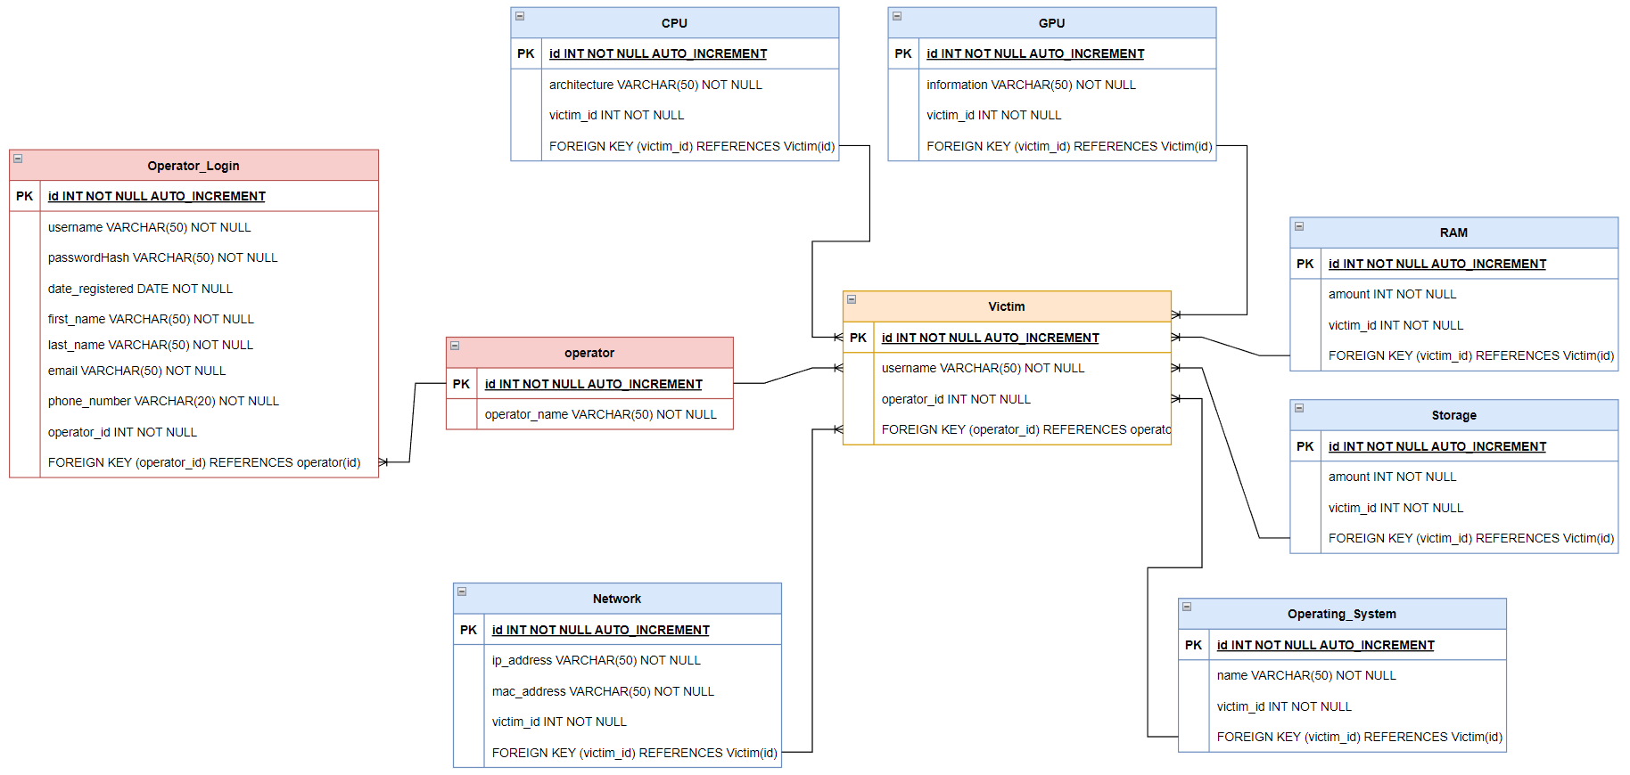
Database
G. Resto, K. Rivera, C. Roque Adversary Emulation Framework
12

Slide 13
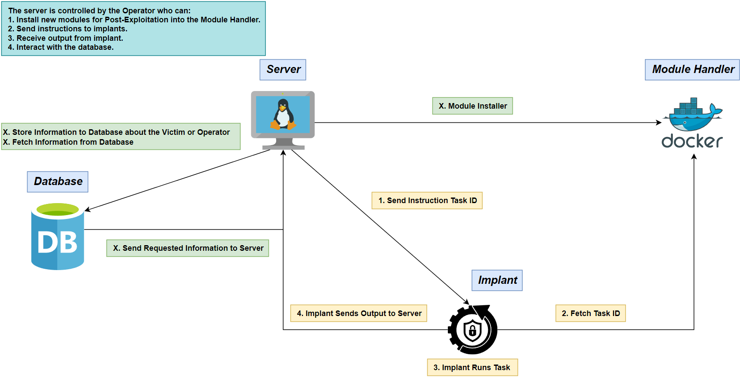
Concept Diagram
G. Resto, K. Rivera, C. Roque Adversary Emulation Framework
13

Slide 14
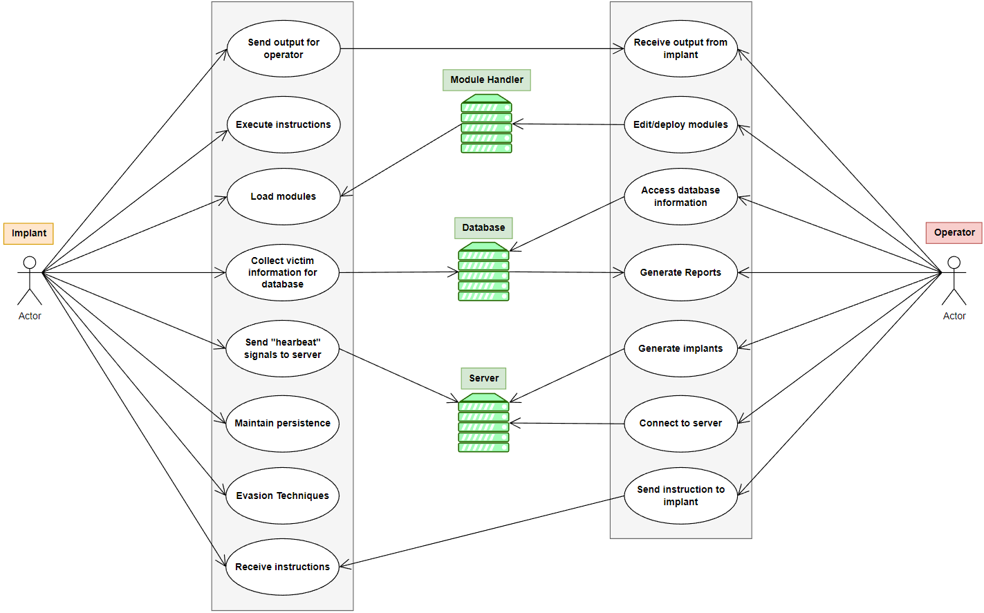
Use Case Diagram
G. Resto, K. Rivera, C. Roque Adversary Emulation Framework
14

Slide 15
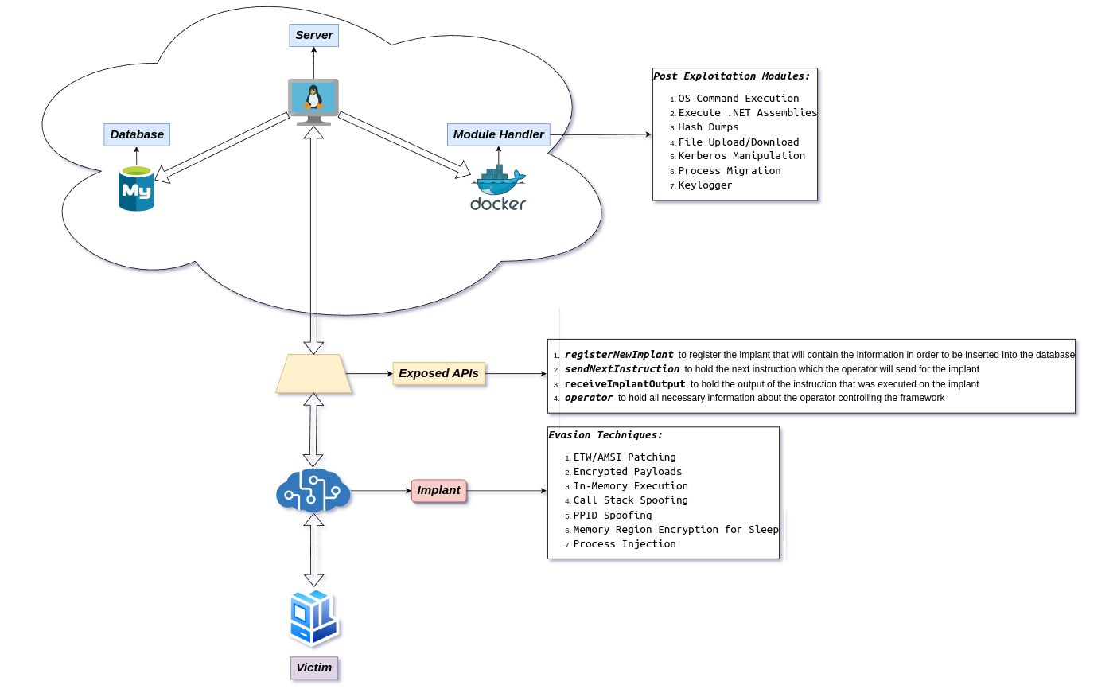
Projected Completion Model
15
G. Resto, K. Rivera, C. Roque Adversary Emulation Framework

Slide 16
References
Microsoft (2023, February). Dynamic Language Runtime Overview - .NET Framework. Microsoft Learn. https://learn.microsoft.com/en-us/dotnet/framework/reflection-and-codedom/dynamic-language-runtime-overview
G. Resto, K. Rivera, C. Roque Adversary Emulation Framework
16

Slide 17

Thank you

